Slide 1
A Comprehensive Study of San Francisco Airport’s passenger flow
(Pre-Pandemic, Pandemic & Post Pandemic)

Slide 2

Introduction
Our project is centered around a comprehensive examination of passenger traffic patterns at San Francisco International and Los Angeles Airports throughout three distinct periods: before COVID19, during the pandemic, and in the post-COVID era.
The core objectives of this analysis are to assess the pandemic's influence on passenger flow, gauge the resilience of various airlines operating at SFO, and chart the airport's recovery trajectory.
We gathered data from Jan 2018 to Dec 2022, (with San Francisco data consisting 7735 records and 2172 records in our Los Angeles dataset)

Slide 3
Hypothesis-1
We hypothesize that COVID-19 had an impact on monthly passenger flow at San Francisco International Airport, resulting in a 50% drop during the pandemic (Jan 2020-Dec 2021) and a subsequent recovery in terms of numbers post-pandemic (Jan 2022-Dec 2022) as that of Pre-Covid (Jan 2018-Dec 2019)

Slide 4
Hypothesis-2
We hypothesize that the heatmap of terminal utilization at San Francisco International Airport will exhibit seasonal variations, reflecting travel patterns, with certain months experiencing more than 30% passenger numbers after Covid (Jan 2022-Dec 2022) as compared to Pre-Covid (Jan 2018-Dec 2019). Additionally, we expect to observe a substantial reduction of 60% in passenger activity across all terminals during pandemic months compared to pre-pandemic months.

Slide 5
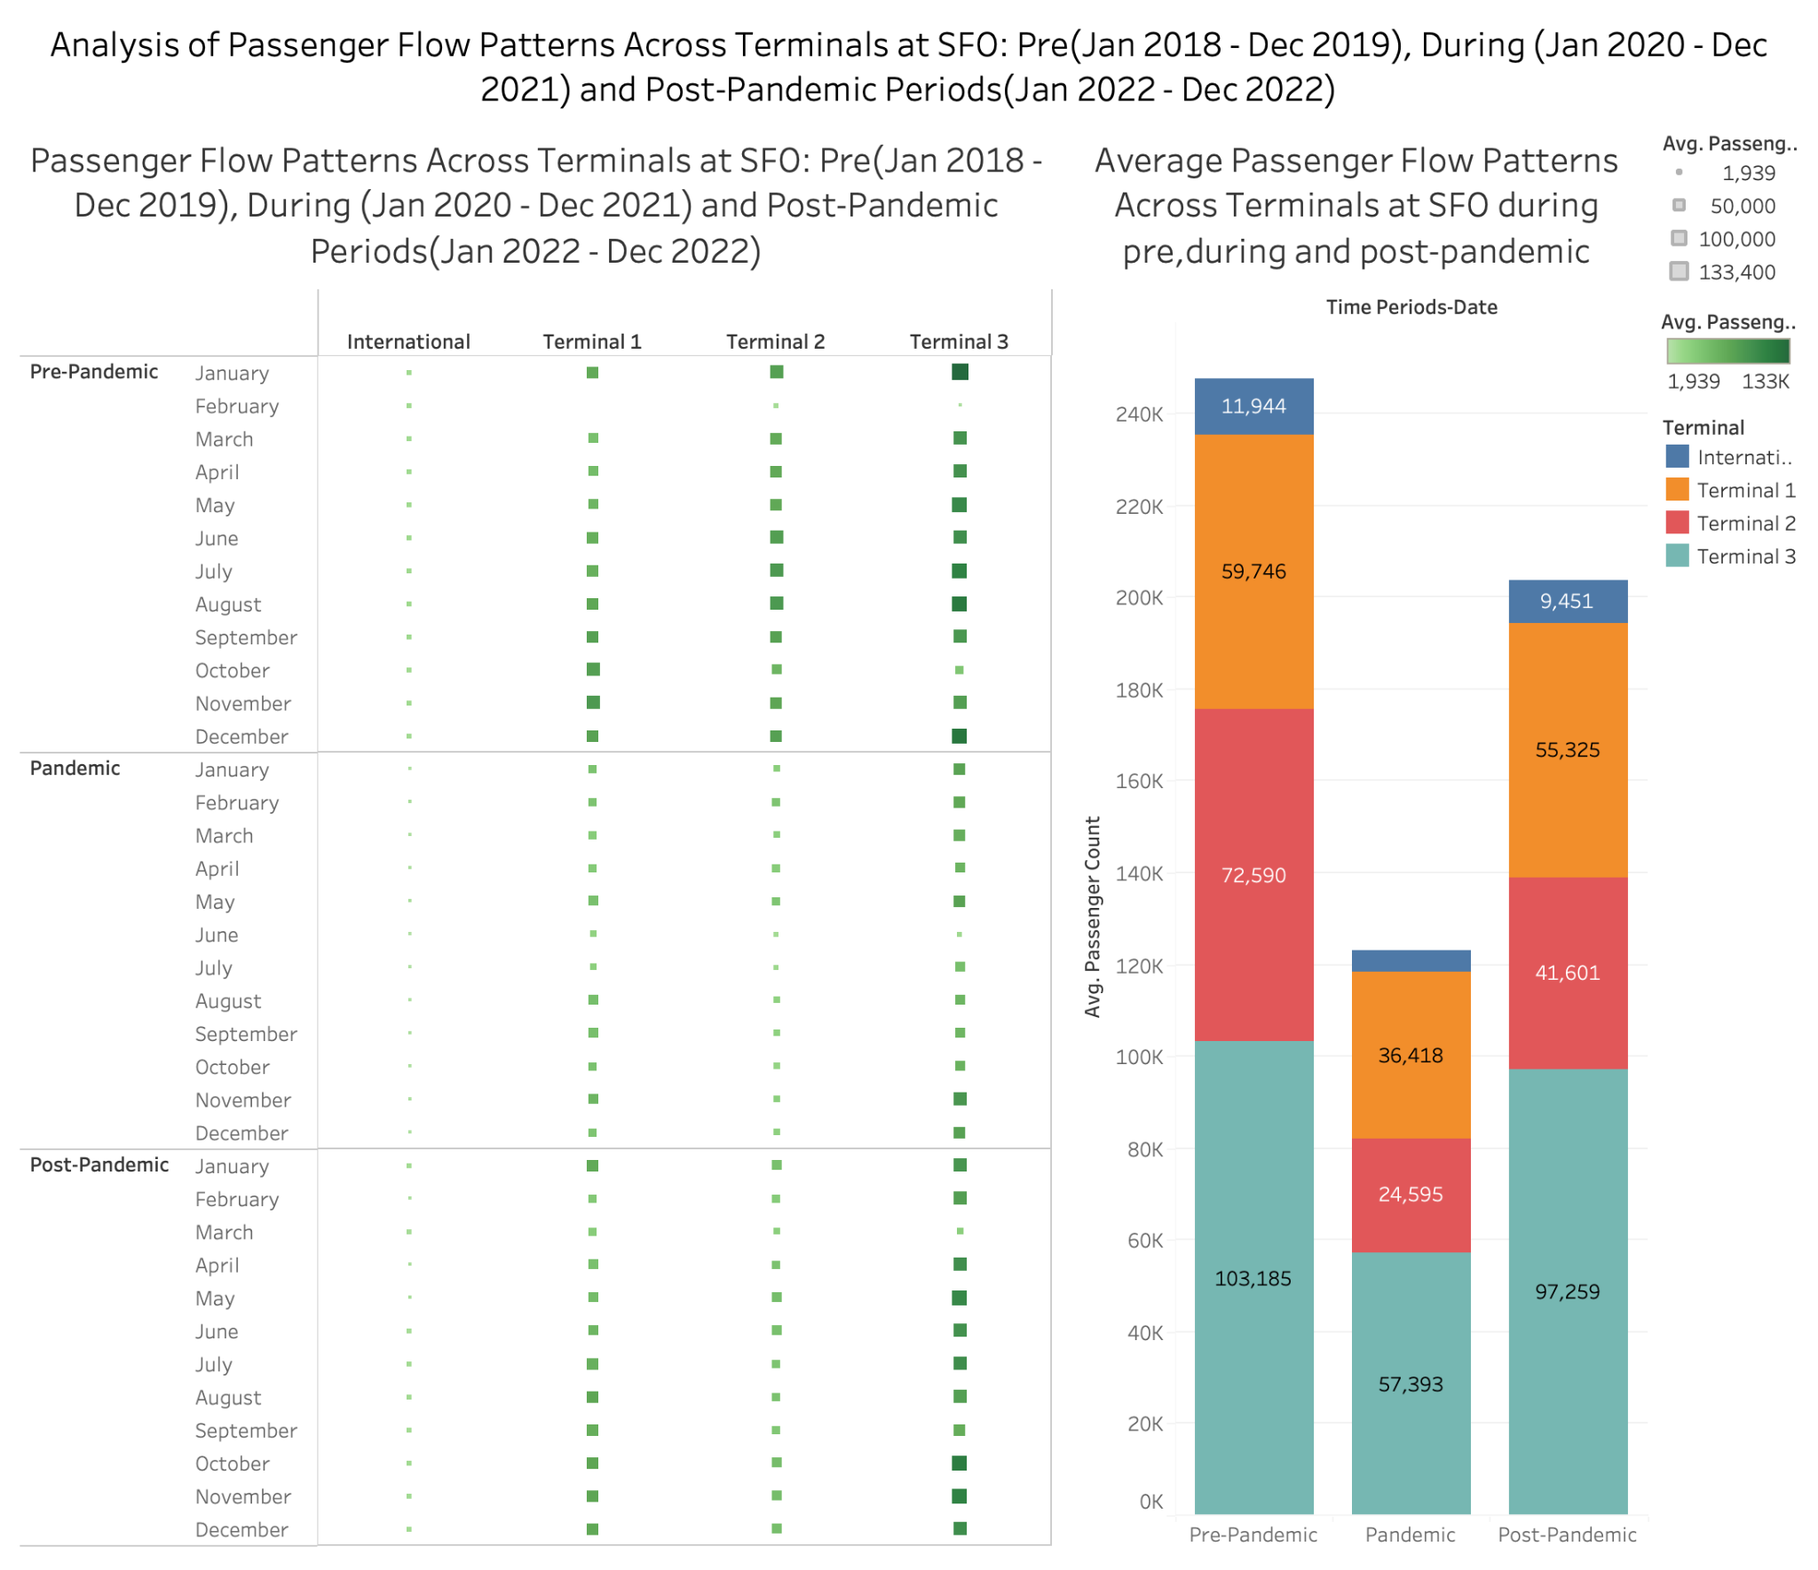

Slide 6
Hypothesis-3
We hypothesize that the pandemic has changed SFO travelers' top airline preferences, specifically United Airlines and Air Canada for international flights and United Airlines, Alaska Airlines, and American Airlines for domestic flights. We'd examine at how their ranks have evolved from pre-covid (Jan 2018-Dec 2019), throughout pandemic (Jan 2020-Dec 2021), and post-covid (Jan 2022-Dec 2022)

Slide 7
Hypothesis-4
We propose a hypothesis suggesting that they are similar in passenger traffic patterns between San Francisco International Airport (SFO) and Los Angeles International Airport (LAX). Specifically, we anticipate that LAX Airport experiences a higher passenger count overall, and that domestic flights outweigh international flights in frequency during both pre-covid (Jan 2018-Dec 2019), throughout covid (Jan 2020-Dec 2021), and post-covid (Jan 2022-Dec 2022)

Slide 8
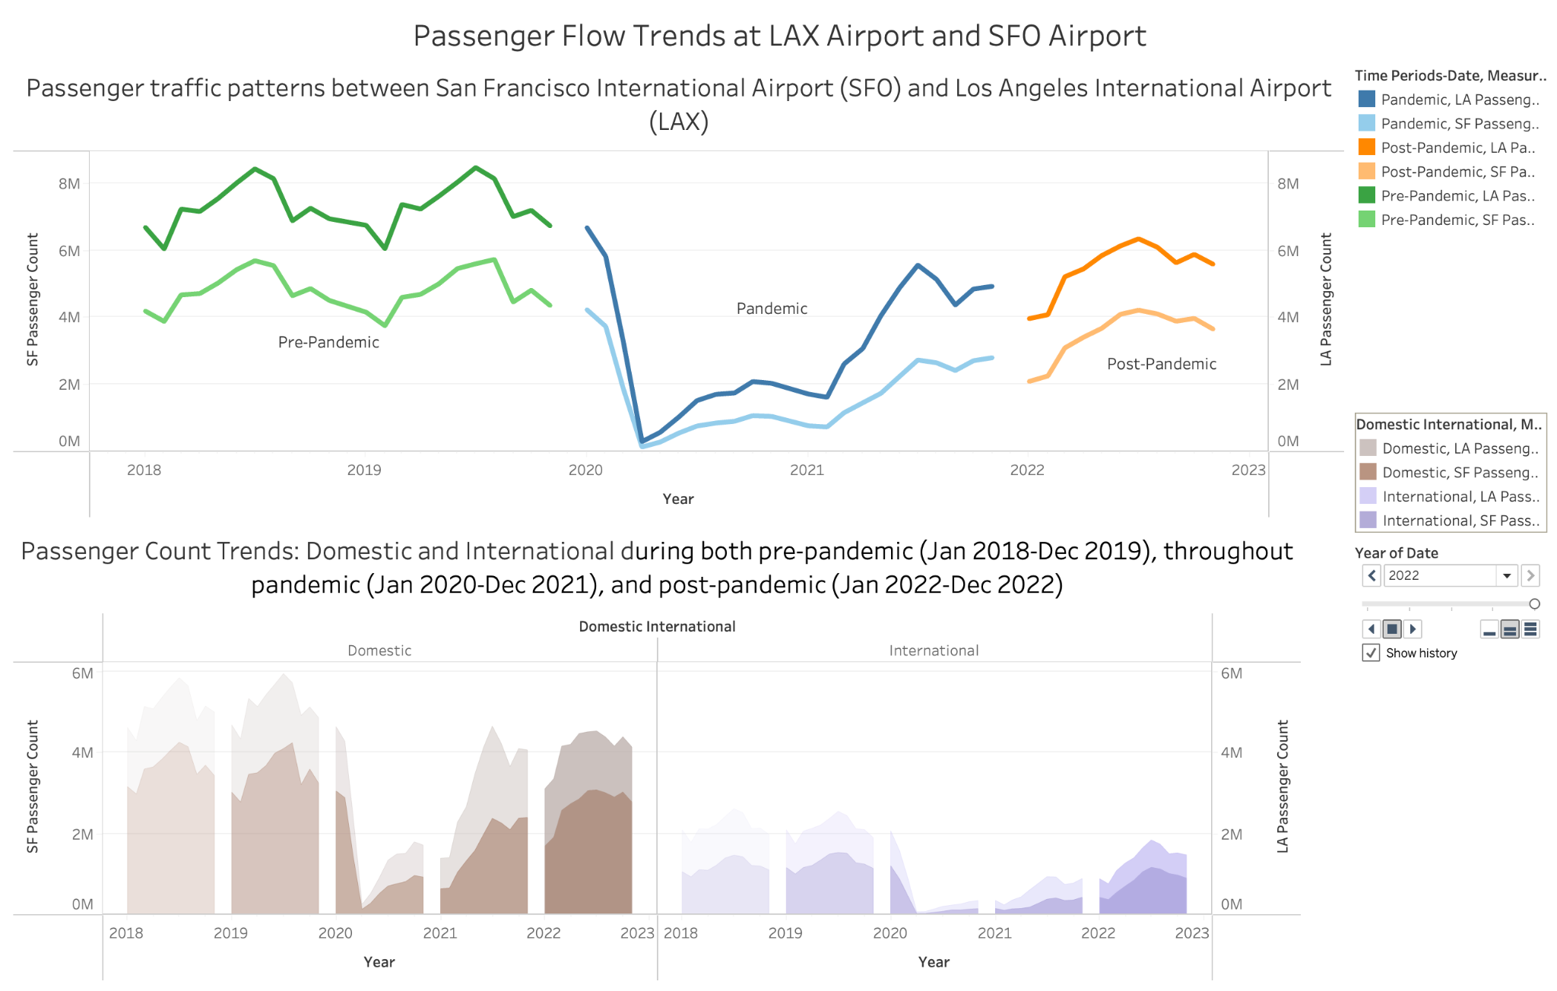

Slide 9
Hypothesis-5
We hypothesize that during Pandemic(Jan 2020-Dec 2021), there will be a 50% decrease in SFO passengers traveling to Asia, and that post-pandemic (Jan 2022-Dec 2022), the passenger count will be similar to that of pre-pandemic (Jan 2018-Dec 2019). Furthermore, we hypothesize that there is a change in the percentages of passengers arriving and departing before, during, and after pandemic, indicating changes in passengers' travel preferences

Slide 10
Conclusion
Pandemic's Influence: Uncovered the significant impact of the COVID-19 pandemic on passenger flow at San Francisco International Airport (SFO) and Los Angeles Airport (LAX) , offering valuable insights into the challenges faced during this period
Implications:
Strategic Response: Highlighted the implications for airport management, airlines, and policymakers, emphasizing the necessity for strategic planning to navigate uncertainties effectively
Next Steps:
Informed Decision-Making: Outlined the pathway for future actions, stressing the importance of ongoing monitoring of passenger trends and the application of insights to make well-informed decisions in the ever-evolving aviation landscape

